Slide 1
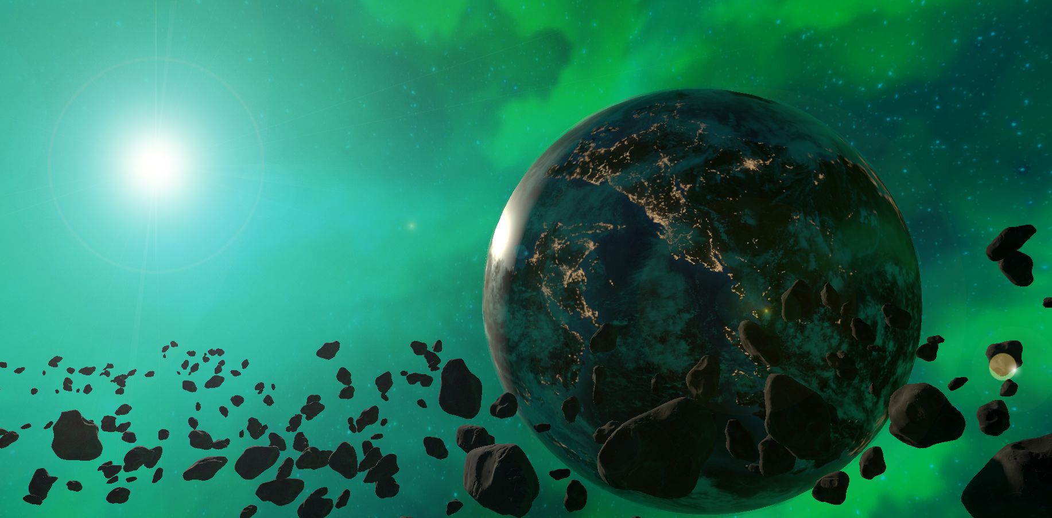

Space Force

Slide 2

Quick Info
Genre:
Realtime Strategy
Perspective:
3D Isometric
Setting:
Sci-Fi Space Battles
Engine:
Unity
Players:
2-8
Age:
12+
Platform:
PC
Input:
Mouse, Keyboard

Slide 3

Core Features
Take control over mighty space ships!
Fight your friends and enemies online!
Control the battlefield and capture map objects to gain an advantage!
Customize your units and experiment with combinations!

Slide 4

Gate I Goals
Polished Movement
Basic Combat
First Map Object
(Unit Editor)

Slide 5


Slide 6

Gate I Goals
Polished Movement
Basic Combat
First Map Object
(Unit Editor)

Slide 7
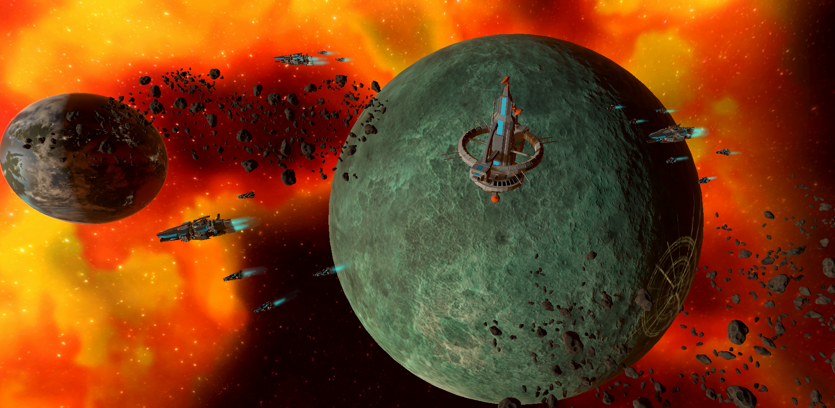

Slide 8
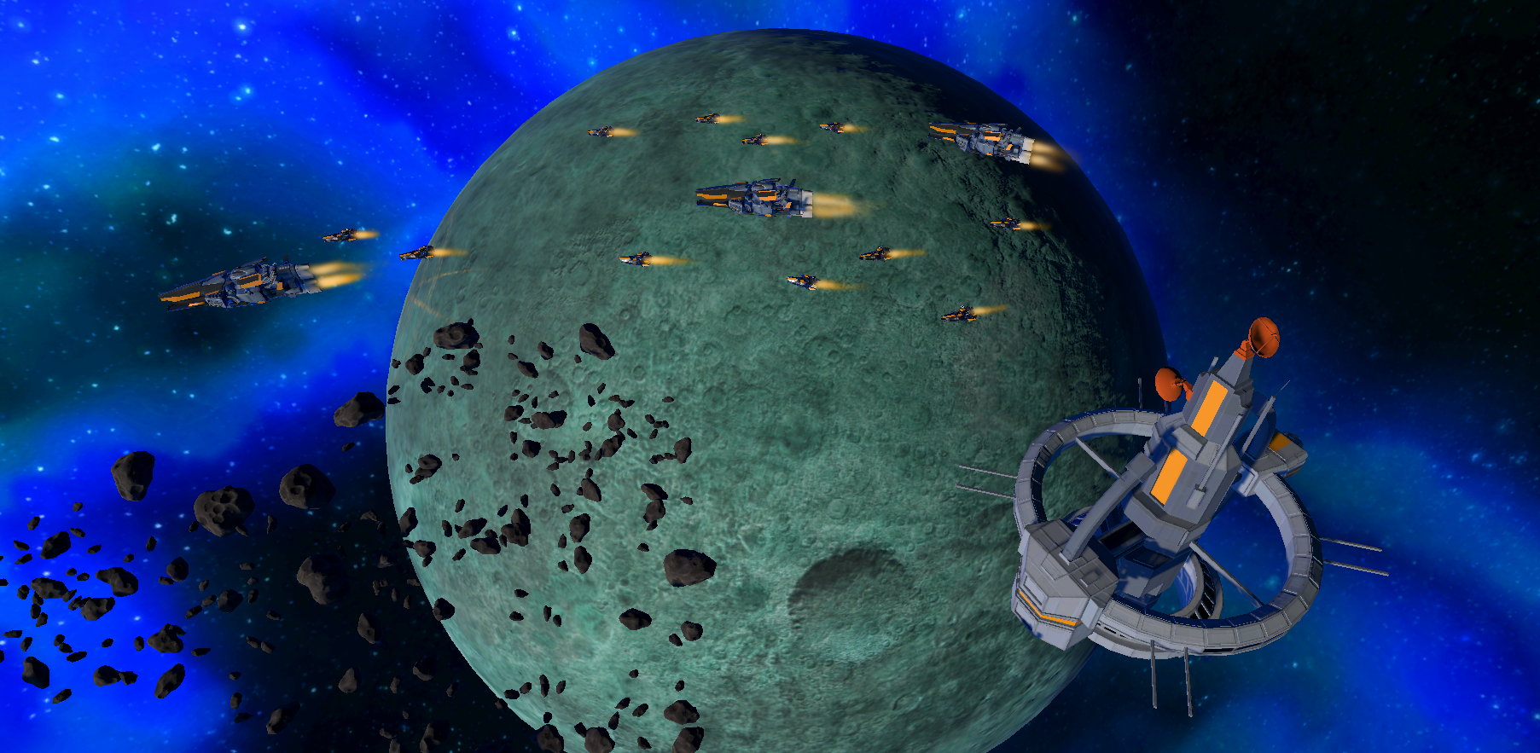

Slide 9
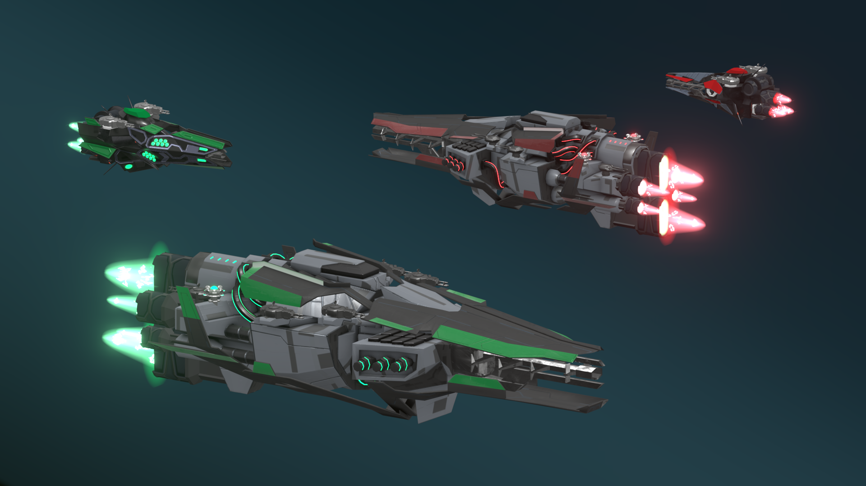

Slide 10
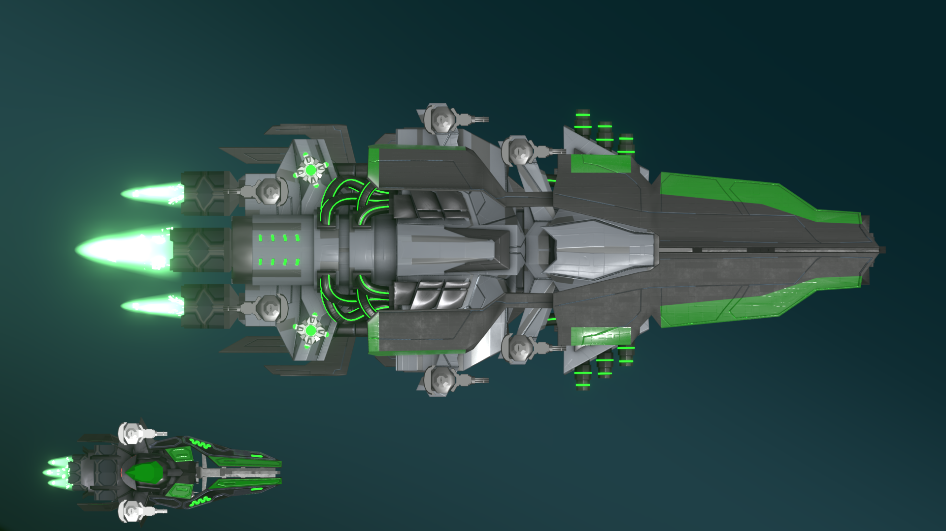

Slide 11
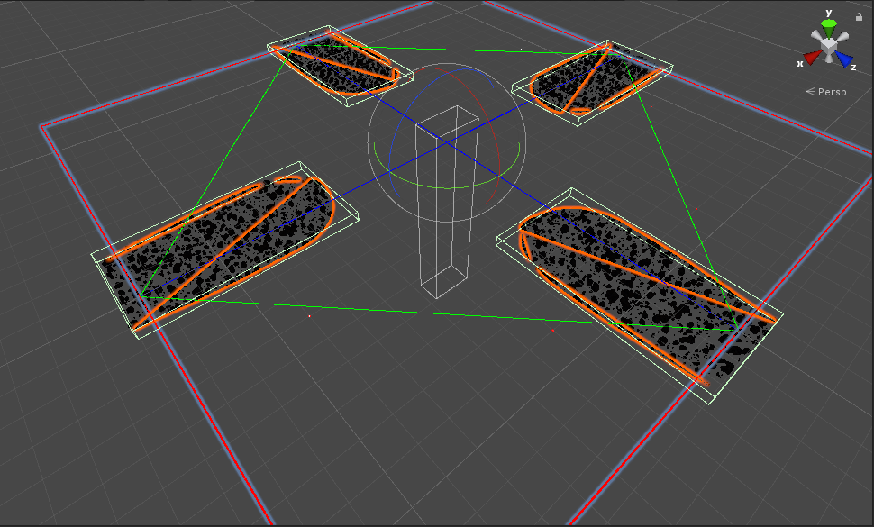

Slide 12
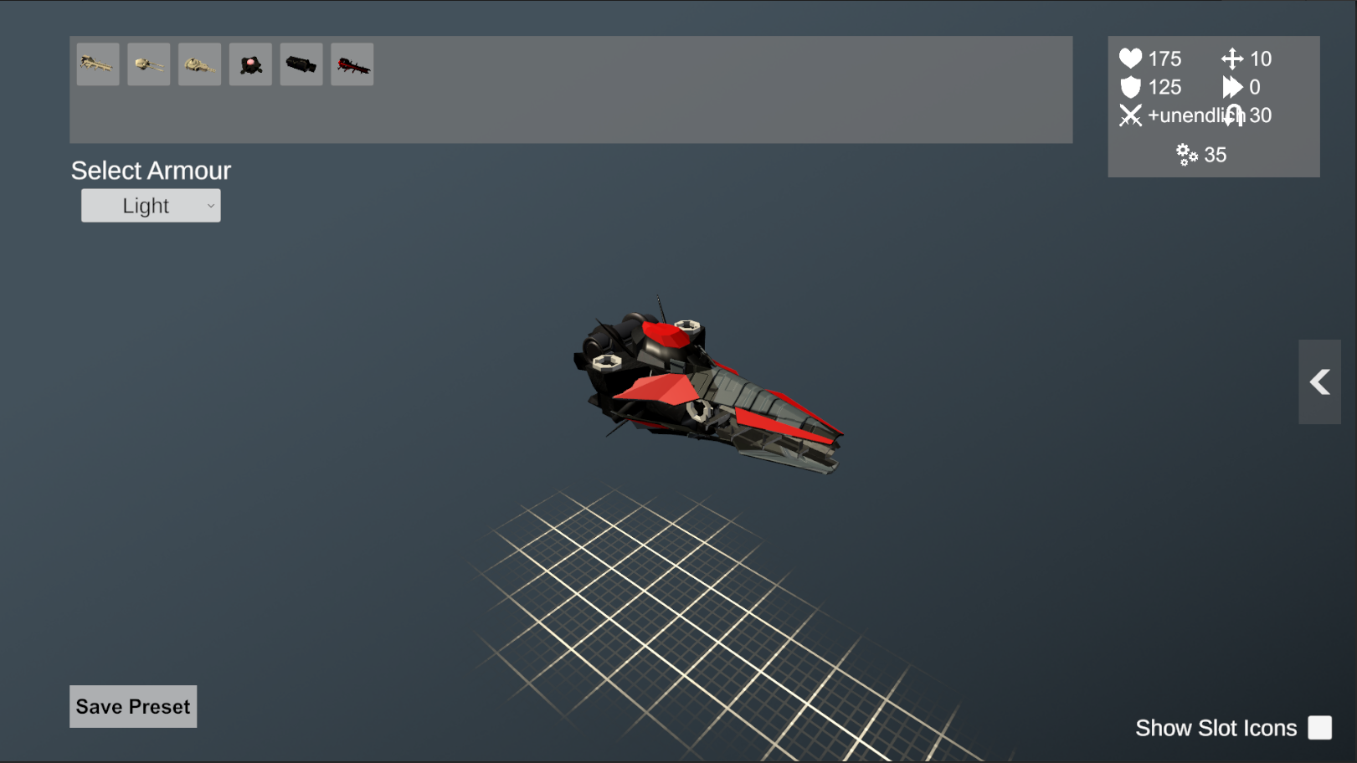

Slide 13
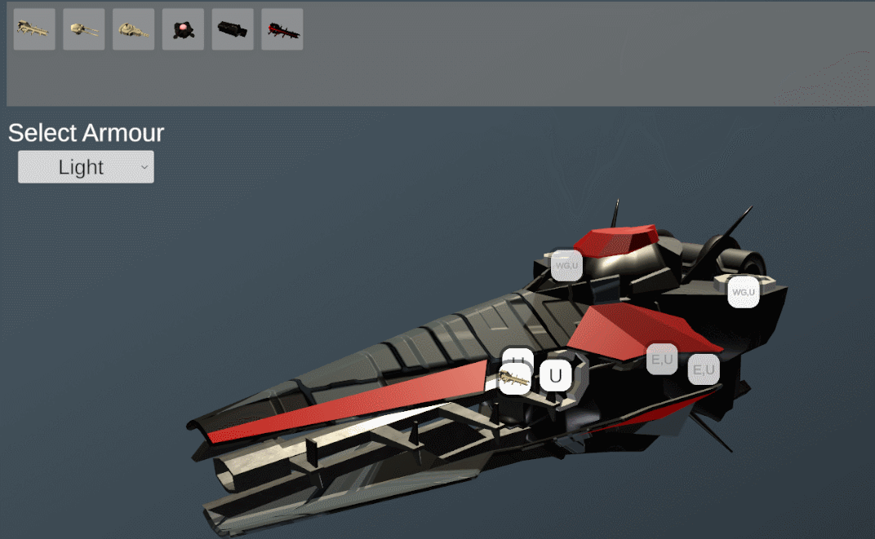

Slide 14
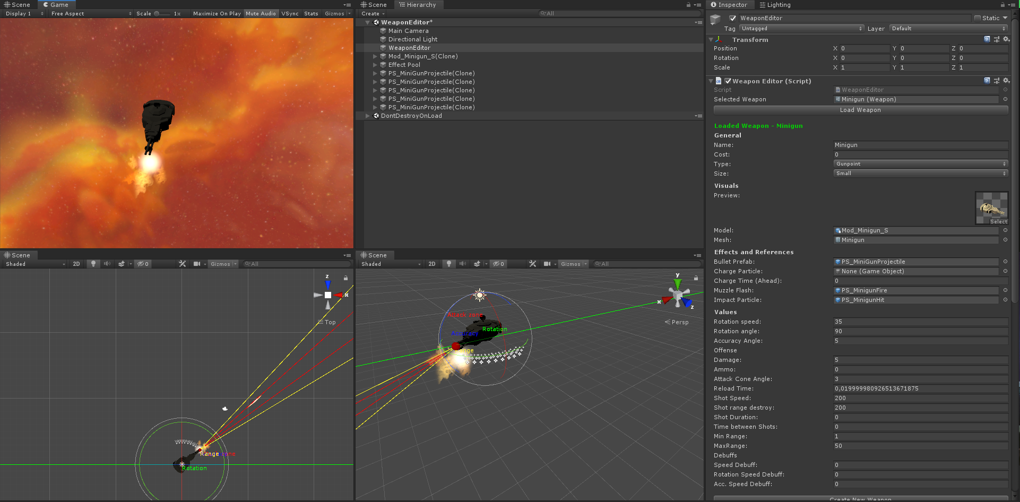

Slide 15

Identified Difficulties
Can’t use most of Unity’s tools!
Pathfinding is a b*tch!
Performance…
Coding standards…

Slide 16
Gate II Goals
Unit Behaviour + Swarm Movement
Combat System and Ship Classes
Unit + Faction Editor
Event System
3+ Maps

Slide 17





Overscoped A. F.
Felix Günther
Felix Günther
Dariush Sanaye
Nils Hausfeld
Johannes Geier
Noah Hübner
Armin Grbic
Lucas Rudziansky
Dennis Alp

Slide 18


Thank you!

